Slide 1
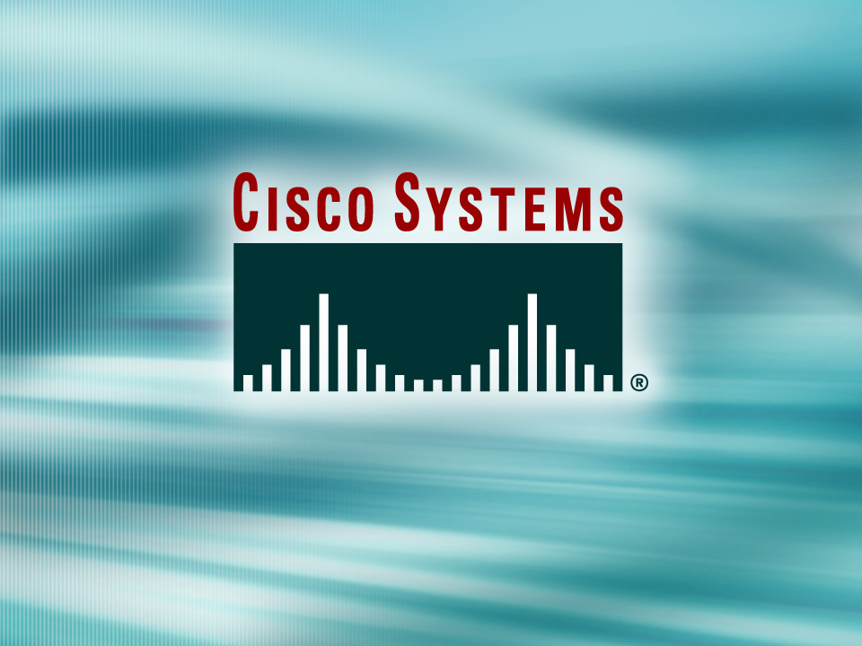
© 2002, Cisco Systems, Inc. All rights reserved.

Slide 2
Establishing Serial
Point-to-Point Connections
Module 7
Notes:
Purpose: This chapter introduces the Cisco IOS™ CLI on the Catalyst® 1900 switch and router.
Timing: This chapter should take about 2 hours to present.
Note: The Catalyst 1900 switch only has a subset of the router Cisco IOS commands available.
Contents:
Introduction to Cisco IOS. Explain to the student what is IOS?
Cisco Device startup procedures in general.
IOS configuration source.
General introduction to the IOS CLI.
Cat 1900 switch startup procedures.
Intro to Cat 1900 CLI. This part covers the basic configuration on the switch, like setting the IP address and hostname. More details about the various Cat 1900 switch configuration commands are explained in Chapter 6 and 7.
Router startup procedures. More details on the router startup process is discussed in chapter 5.
Router IOS CLI.

Slide 3
Objectives
Upon completing this module, you will be able to:
  Use Cisco IOS commands to configure serial interfaces using HDLC and PPP encapsulation for leased-line connections, given a functioning router
  Use show commands to identify anomalies in HDLC and PPP encapsulation for leased-line connections, given an operational router
  Use debug commands to identify events and anomalies in HDLC and PPP encapsulation for leased-line connections, given an operational router
Notes:
Slide 1 of 2
Purpose: This slide states the chapter objectives.
Emphasize: Read or state each objective so that each student has a clear understanding of the chapter objectives.
Note: Catalyst switches have different CLIs. The Catalyst 2900xl and the Catalyst 1900 has a Cisco IOS CLI. The Cisco IOS CLI commands available on the 2900xl is different from the 1900. The Catalyst 5000 family has no Cisco IOS CLI, and use the set commands instead. This class only covers the configuration on the Catalyst 1900 switch.

Slide 4

Wide-Area Networking Review
© 2002, Cisco Systems, Inc. All rights reserved.
Notes:
Purpose: This chapter introduces the Cisco IOS™ CLI on the Catalyst® 1900 switch and router.
Timing: This chapter should take about 2 hours to present.
Note: The Catalyst 1900 switch only has a subset of the router Cisco IOS commands available.
Contents:
Introduction to Cisco IOS. Explain to the student what is IOS?
Cisco Device startup procedures in general.
IOS configuration source.
General introduction to the IOS CLI.
Cat 1900 switch startup procedures.
Intro to Cat 1900 CLI. This part covers the basic configuration on the switch, like setting the IP address and hostname. More details about the various Cat 1900 switch configuration commands are explained in Chapter 6 and 7.
Router startup procedures. More details on the router startup process is discussed in chapter 5.
Router IOS CLI.

Slide 5
Objectives
Upon completing this lesson, you will be able to:
  Describe leased-line, circuit-switched, and
  packet-switched networks
  Define terms used by WAN service providers including CPE, demarcation, local-loop, CO, and toll network
  Identify the five serial standards supported by Cisco devices
  Describe the major WAN protocols including HDLC, PPP, SLIP, X.25, Frame Relay, and ATM
Notes:
Slide 1 of 2
Purpose: This slide states the chapter objectives.
Emphasize: Read or state each objective so that each student has a clear understanding of the chapter objectives.
Note: Catalyst switches have different CLIs. The Catalyst 2900xl and the Catalyst 1900 has a Cisco IOS CLI. The Cisco IOS CLI commands available on the 2900xl is different from the 1900. The Catalyst 5000 family has no Cisco IOS CLI, and use the set commands instead. This class only covers the configuration on the Catalyst 1900 switch.

Slide 6
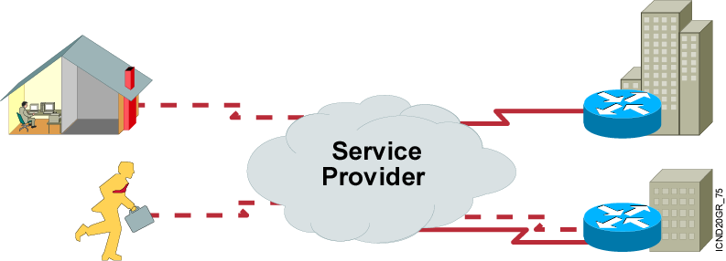
WAN Overview
WANs connect remote sites.
Connection requirements vary depending on user requirements, cost, and availability.
Notes:
Purpose: This figure introduces students to WAN connections.
Emphasize: Highlight the interconnected WAN connections between the various company sites. The site graphically present a mobile dial-up user, a telecommuter using a DDR connection, and two office sites with multiple connections.
This course teaches students how to configure a WAN. Tell students that a WAN is a data communications network that serves users across a broad geographic area.
Transition: Following are the various physical connections that will connect these sites.

Slide 7
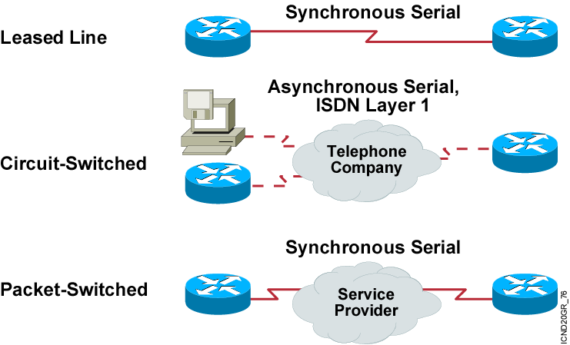
WAN Connection Types: Layer 1
Notes:
Purpose: This figure introduces students to various physical WAN connections.
Emphasize: Leased lines have point-to-point connections that are indefinitely reserved for transmissions, rather than switched as transmission is required. Typically, a leased connection is made using serial lines.
Circuit-switched connections are dedicated physical circuit paths established only during the duration of a call. Physical circuit-switched examples are asynchronous serial and ISDN.
Packet-switched networks use packet switching technology for data transfer.
Evolving physical connections not discussed in this course follow:
Digital subscriber line (DSL)—DSL is an emerging technology that delivers high bandwidth over conversational copper lines. There are four varieties of DSL: asymmetric digital subscriber line (ADSL), high-data-rate digital subscriber line (HDSL), single-line digital subscriber line (SDSL), and very-high-data-rate digital subscriber line (VDSL). Because most DSL technologies do not use the whole bandwidth of the twisted pair, there is room left for a voice channel.
Cable—Cable is an emerging technology for data transport that uses a coaxial cable medium to transport the data. It is a good choice in emerging markets such as China where copper pairs for telephones are not standardized.

Slide 8
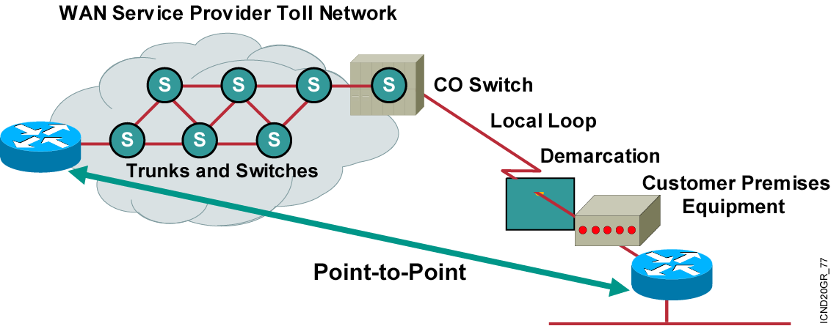
Interfacing Between
WAN Service Providers
Provider assigns connection parameters
to subscriber.
Notes:
Purpose: This figure identifies the terms of various devices used to complete the WAN connection.
Note: CPE includes both the devices owned by the subscriber and devices leased to the subscriber by the service provider.
The demarc often occurs at a telecommunication closet (a room containing a punch-down block of provider wiring).
Usually the local loop extends for a relatively short distance to the nearest telephone company premises.
The central office acts as:
An entry point to the WAN cloud for calling.
An exit point from the WAN for called devices.
A switching point for calls that traverse the facility.
Inside the long-distance toll network are several types of central offices. For example, a calling subscriber’s connection on a local loop can enter an end central office switch and access an interoffice trunk to a toll central office. In most U.S. locations, AT&T, Sprint, and MCI offer toll offices to handle their subscribers’ calls.
Within the provider’s cloud, the caller’s traffic may cross a trunk to a primary center, then go to a sectional center, and then to a regional or international carrier center as the call goes the long distance to its destination.
A called subscriber can receive a call that has traversed the trunks and switches of a similar hierarchy of central offices. The called subscriber receives the call over the local loop from the called subscriber’s end central office.
Often, for point-to-point circuits spanning regional or national boundaries, several providers handle a connection in the toll network.

Slide 9
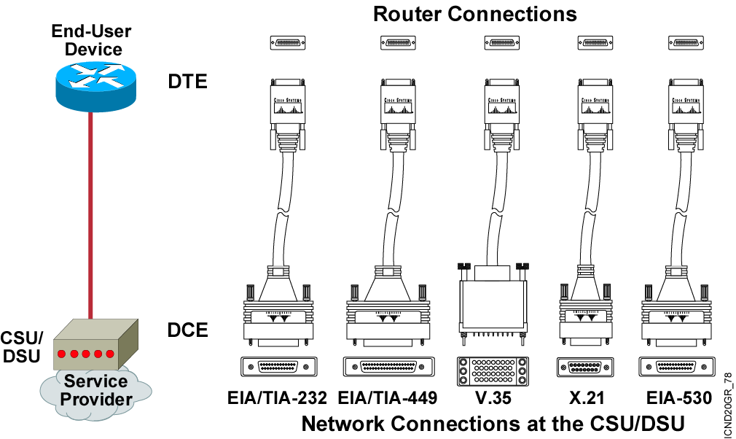
Serial Point-to-Point Connections
Notes:
Purpose: This section describes the various serial standards that support leased-line connections.
Emphasize: The same 60-pin end that attaches to a Cisco device supports all the standards illustrated.
Note: Data switching equipment (DSE) is an additional term sometimes used to describe the switch components that appear inside the cloud. The DSE adds and removes channels assigned inside the WAN. The DSE connects traffic from various sources to their final destinations through other switches.
Transition: The next layer in the stack is Layer 2, the data link layer.

Slide 10
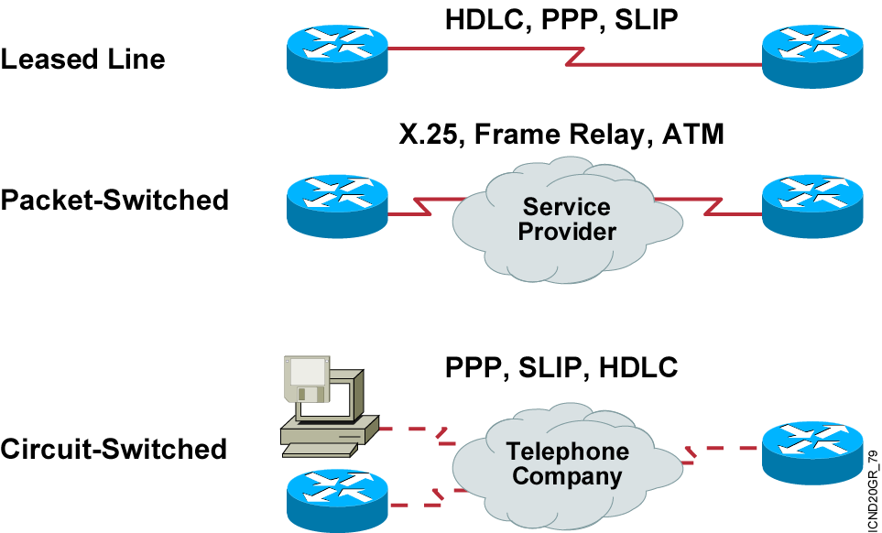
Typical WAN Encapsulation Protocols: Layer 2
Notes:
Purpose: This figure introduces students to various encapsulation options to use over the various physical connections.
Emphasize: In order to exchange traffic over a WAN link, the packets must be encapsulated into a Layer 2 frame. There are a variety of Layer 2 encapsulation types available that can be used, depending on the WAN connection being used. Some of the types are listed the figure.
Encapsulation must be configured on the router when configuring the interface. Some of these encapsulation types will be seen again in the following chapters.
In an ISDN environment, the Point-to-Point Protocol (PPP) is the B channel’s Layer 2 encapsulation. Link Access Procedure on the D channel (LAPD) is the encapsulation for the D channel.
Either the proprietary Cisco or Internet Engineering Task Force (IETF) (defined in RFC 1490) encapsulations are the Layer 2 encapsulations for Frame Relay.
Note: Other encapsulations not shown include AppleTalk Remote Access Protocol (ARAP), Compressed Serial Link Internet Protocol (CSLIP), or Synchronous Data Link Control (SDLC).
Transition: We will first look at the HDLC encapsulation.

Slide 11
Summary
  A WAN makes data connections across a broad geographic area so that information can be exchanged between distant sites.
  Some of the WAN connection types available are leased line, circuit-switched, and packet-switched.
  Cisco routers support the EIA/TIA-232, EIA/TIA-449, V.35, X.21, and EIA/TIA-530 standards for serial connections.
  To encapsulate data for crossing a WAN link, you can choose from a variety of Layer 2 protocols, including HDLC, PPP, SLIP, X.25/LAPB, Frame Relay, and ATM.
Notes:
Purpose: This slide discuss the initial configurations on the routers and switches.
Note: There is no setup mode on the Catalyst 1900 switch.

Slide 12
